Slide 2
New artifacts in LOINC 2.61
Table core
Part file
Answer file
Group file
And a revamped Multi-axial hierarchy!

Slide 3
LOINC Table Core
Goal: to make it easier for implementers to update to the latest LOINC release without changing their database structure
Contains all of the LOINC terms that are in the full LOINC Table
>84,500 rows
With a subset of fields for each term
15 columns…versus 46 columns in the full table
Fields included are the ones that are crucial for defining each LOINC term and whose structure is not likely to change in the short-term
The core table file also includes the LOINC MAP_TO table, which contains recommendations for which terms discouraged and deprecated terms should be mapped to

Slide 4
LOINC Table Core Fields
LOINC_NUM
COMPONENT
PROPERTY
TIME_ASPCT
SYSTEM
SCALE_TYP
METHOD_TYP
CLASS
CLASSTYPE
LONG_COMMON_NAME
SHORTNAME
EXTERNAL_COPYRIGHT_NOTICE
STATUS
VersionFirstReleased
VersionLastChanged

Slide 5
(LOINC Table Core preview)

Slide 6
LOINC Part File
Includes three CSV files
Part_Alpha_1.csv
All of the primary parts associated with any LOINC term in the current release
~50,000 unique records
LoincPartLink_Alpha_1.csv
Contains links between LOINC terms and their parts
>860,000 links between >84,500 LOINC terms and 50,000 unique parts
PartRelatedCodeMapping_Alpha_1.csv
Contains mappings from LOINC Parts to corresponding concepts in other terminologies
First release will contain nearly 8700 records (~850 RadLex, 990 RxNorm, 6800 SCT)

Slide 7
Part_Alpha_1.csv
Four major categories of parts in this file:
Six main parts that define a LOINC term (Component, Property, Time Aspect, System, Scale, and Method)
Additional parts that contribute to the term, such as the Divisor, Challenge, and Class
Document ontology parts
Radiology parts based on the LOINC/RSNA unified model

Slide 8
Part_Alpha_1.csv (cont.)
List of fields:
PartNumber (e.g. LP129068-5)
PartTypeName (e.g. Component, Rad.Anatomic location.Imaging focus)
PartName (e.g. Hemoglobin, Clavicle)
PartDisplayName
Status (ACTIVE, DEPRECATED)
Included in the file: Parts associated with Deprecated LOINC terms
NOT included in this file: Parts that are no longer used to define any published LOINC term, even if those parts were previously released

Slide 9
LoincPartLink_Alpha_1.csv
List of fields:
LoincNumber
LongCommonName
PartNumber
PartName
PartTypeName
LinkTypeName (Primary, Search, DocumentOntology, Radiology)

Slide 10
LoincPartLink_Alpha_1.csv (cont.)
Link types for each LOINC term as appropriate:
“Primary” LOINC term ↔ primary parts (e.g. Component, Property, Time, System, Scale, Method)
“Search” LOINC term ↔ search-related parts
“Radiology” LOINC term ↔ radiology parts
“DocumentOntology” LOINC term ↔ document ontology parts

Slide 11
PartRelatedCodeMapping_Alpha_1.csv
Contains the subset of LOINC parts that are mapped to a concept in an external terminology (SNOMED CT, RadLex, RxNorm)
List of fields:
PartNumber
PartName
PartTypeName
MapTargetId - the unique external concept identifier
MapTargetName - the external concept name
MapTargetCodeSystem - the coding system (SCT, RadLex) to which the external identifier belongs
MapType - specificity of mapping between the LOINC part and the external concept (Exact, LOINC broader, LOINC narrower)
ContentOrigin - an indicator of the origin of the concept (LN, Both)

Slide 12
(LOINC Part artifact preview)

Slide 13
LOINC Answer File
Includes two CSV files:
AnswerList_Alpha_1.csv
Contains all LOINC answer lists that are associated with any LOINC term in the current release
>3,400 unique answer lists
LoincAnswerListLink_Alpha_1.csv
Contains links from LOINC codes in the current release to their answer list(s)
>15,000 unique rows linking >15,000 LOINC terms to ~3,000 unique answer lists

Slide 14
AnswerList_Alpha_1.csv
Two types of answer lists
Enumerated lists with LOINC Answer Strings
Externally defined Answer lists
Includes the initial set of LOINC answer string to SNOMED CT mappings (~250 unique maps)
Included in this file: Answer lists associated with Deprecated LOINC terms
NOT included in this file: Answer lists that were previously released but are no longer linked to any published LOINC term

Slide 15
AnswerList_Alpha_1.csv
List of fields
AnswerListId (prefix "LL“)
AnswerListName
AnswerListOID
ExtDefinedYN (Y, N)
ExtDefinedAnswerListCodeSystem (e.g. SCT)
ExtDefinedAnswerListLink
AnswerStringId (prefix "LA“)
LocalAnswerCode (e.g. code on a form)
LocalAnswerCodeSystem
SequenceNumber
DisplayText
ExtCodeId
ExtCodeDisplayName
ExtCodeSystem
ExtCodeSystemVersion
CopyrightNotice
SubsequentTextPrompt (e.g. “Other”, “Please specify:”)
Description
Score

Slide 16
LoincAnswerListLink_Alpha_1.csv
List of fields:
LoincNumber
LongCommonName
AnswerListId
AnswerListName
AnswerListLinkType (Example, Preferred, Normative)
ApplicableContext (if applicable, the panel context in which an answer list other than the default list is attached to a LOINC term)

Slide 17
LoincAnswerListLink_Alpha_1.csv (cont.)
Example of a LOINC term linked to multiple answer lists in different contexts:
83234-5 Prior device use [CMS Assessment] …included in two different CMS panels; question meaning is the same but the answer choices are different
85639-3 LCDS - Functional abilities and goals
(Long-Term Care Hospital (LTCH) Continuity Assessment Record and Evaluation (CARE) Data Set)
83234-5 Prior device use [CMS Assessment]
Manual wheelchair
Motorized wheelchair or scooter
Mechanical lift
None of the above
83268-3 IRF-PAI - Functional abilities and goals – admission
(Inpatient Rehabilitation Facility - Patient Assessment Instrument)
83234-5 Prior device use [CMS Assessment]
Manual wheelchair
Motorized wheelchair or scooter
Mechanical lift
Walker
Orthotics/Prosthetics
None of the above

Slide 18
(LOINC Answer list artifact preview)

Slide 19
LOINC Group File
A flexible and computable tool that provides groups of LOINC codes for various purposes
Use cases:
Aggregating data for displaying on a flowsheet
Retrieving data for quality measure reporting
Collecting data for research

Slide 20
LOINC Group File (cont.)
Currently contains 13 Parent groups and 2000+ Groups
List of fields:
ParentGroupID (prefix “LG”)
ParentGroup
ParentGroupCategory (Clinical, Laboratory)
ParentGroupDescription
GroupID (also prefix “LG”)
Group
LoincNumber
LongCommonName

Slide 21
LOINC Group File (cont.)
**Use with caution**
The distributed LOINC Group file is a work in progress. Expect the contents of this file, including the types of Groups that are included, to change from release to release as we receive feedback from users and refine our processes.
The contents of the file and the groupings MUST be validated by the user prior to implementation in any aspect of clinical care.

Slide 22
LOINC Group File - Example
Parent Group: LG70-5 (BodyMeasurements, SAME:Comp|Prop|Tm|Sys, ROLLUP:Method)
ParentGroupCatergory: Clinical
ParentGroupDescription: Contains individual groups for non-fetal body weight, body height and head circumference, where each group contains all terms for that particular measurement regardless of the method.
Groups within Parent Group:
LG10305-7 (Body weight|Mass|Pt|^Patient)
LG10304-0 (Body height|Len|Pt|^Patient)
LG10306-5 (Circumference.occipital-frontal|Len|Pt|Head)

Slide 23
LOINC Group File - Example
Parent Group – LG70-5, Body Measurements
8339-4
Body weight Measured
8350-1
Body weight Measured --with clothes
Group – LG10304-0, Body Height
8306-3
Body height --lying
Group – LG10305-7, Body Weight
3137-7
Body height Measured
Group – LG10306-5, Head circumference
8287-5
OFC by Tape measure
8288-3
OFC by Ultrasound

Slide 24
(LOINC Group artifact preview)

Slide 25
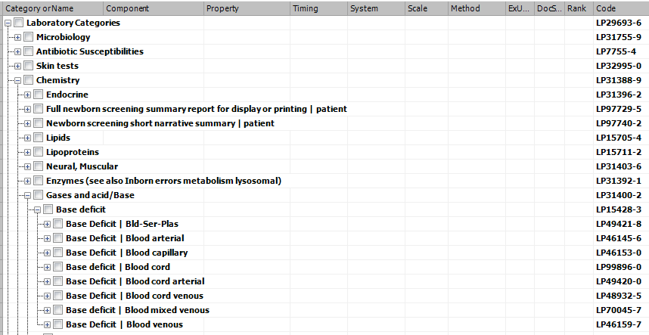
LOINC Multi-axial hierarchy
Organization of codes based on multiple axes of each concept
Available in RELMA and as separate download from the LOINC website (https://loinc.org/downloads/accessory-files/)
Originally created for the laboratory class
Organized by:
Class →
Component →
System

Slide 26
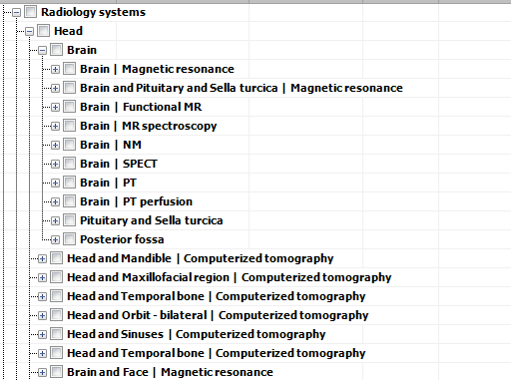
LOINC Multi-axial hierarchy (cont.)
Over time, other domains (not all) were added to the hierarchy
Most based on the same organization as for lab terms
Radiology terms organized
by: System → Modality

Slide 27
LOINC Multi-axial hierarchy (cont.)
As of LOINC version 2.60, all LOINC terms are in the hierarchy
Everything except the radiology domain is organized based on Class → Component → System
However, in some domains, such as survey instruments, the Components are not included in the Component tree and System is ^Patient for all, so to include these, we created a “Not yet categorized” node
We plan to review the uncategorized terms and will likely create new organization strategies for certain domains, such as Document Ontology and Surveys, similar to what we have done for Radiology

Slide 28
(Multi-axial tree preview: RELMA & table)

Slide 29
Existing LOINC Artifacts
LOINC Table
LOINC Top 2000+ Results
LOINC Universal Lab Order Value Set
LOINC Common UCUM Codes
LOINC Document Ontology
LOINC Imaging Document Codes
LOINC Panels and Forms
LOINC RSNA Radiology Playbook
LOINC SNOMED CT Mappings
LOINC IEEE Mappings
LOINC Linguistic Variants
Available for download:
https://loinc.org/downloads/loinc/
https://loinc.org/downloads/accessory-files/

